Slide 1
Finding What You Need in SQL Docs
SQL PASS SUMMIT 2020
FOCUS GROUP

Slide 2
Agenda
Introductions
What’s new in SQL Docs?
Azure SQL rebranding & content organization
Azure Arc
Tips & Tricks:
Hub and landing pages
Navigation: Headers and Breadcrumbs
Navigation: TOC and Right Nav
Versioning
SQL Server offline content (previous versions)
You can edit SQL Docs!
Article feedback and Microsoft Q & A
Open discussion:
What is your feedback on SQL Documentation?

Slide 3
Introductions

Slide 4
SQL Docs: Who are we?
SQL documentation team covering docs.microsoft.com content for:
SQL Server
Azure SQL
Azure Synapse Analytics
Interact closely with the product team and customers to try to create, organize, and maintain quality content for SQL customers.

Slide 5
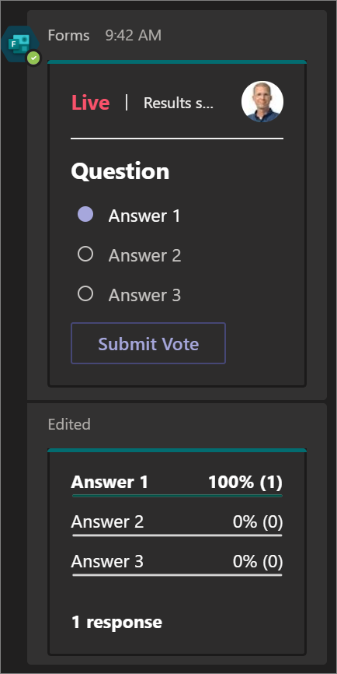
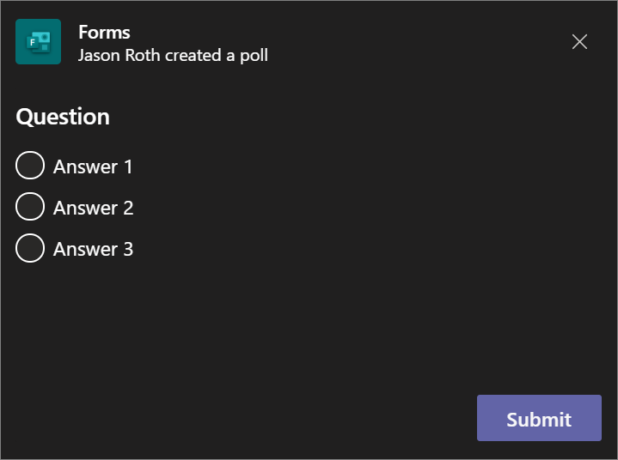

Who are you?
Throughout the focus group we’ll launch polls in teams to learn more about you and what you think.
At any time, use the hand-raise feature or just speak up to ask a question or make comment:
Popup
In Meeting Chat
Notes:
Poll: What is your role?
Poll: How often do you use SQL documentation on docs.microsoft.com?

Slide 6
What’s New in SQL Docs?

Slide 7
Azure SQL rebrand and reorganization
https://aka.ms/azuresqldocs
Previous term | New term
Azure SQL Database Managed Instance | Azure SQL Managed Instance
Azure SQL Database single database | Azure SQL Database
Azure SQL Database elastic pool | Azure SQL Database
N/A | SQL Server on Azure VMs
N/A | Azure SQL
Notes:
Poll: Were you users of our Azure SQL Database documentation last year?
Poll: How do you feel about the new Azure SQL docs structure?

Slide 8
Azure Arc enabled data services
Preview release at Ignite 2020:
Azure Arc enabled data services (preview):
Run Azure data services on-premises, at the edge, and in public clouds using Kubernetes and the infrastructure of your choice.
Azure Arc enabled SQL Server (preview):
Extends Azure services to SQL Server instances hosted outside of Azure in your own datacenter, on the edge, or in a multi-cloud environment.
Part of the hybrid story provided by Arc all-up.

Slide 9
Tips & Tricks

Slide 10
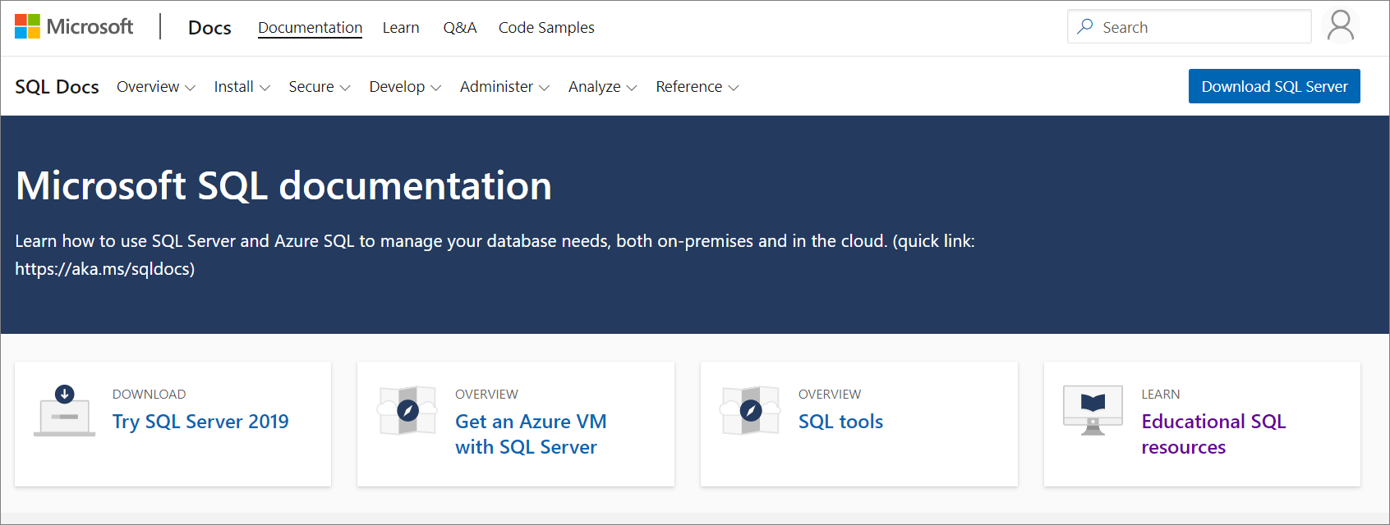
Hub and landing pages
Hub page:
Covers a broad area with links to information in the docs
Examples:
SQL Server Hub (http://aka.ms/sqldocs),
Azure Hub
Landing page:
Provides curated links to information within a section of the docs
Examples: SQL Server, Azure SQL (https://aka.ms/azuresqldocs)

Slide 11
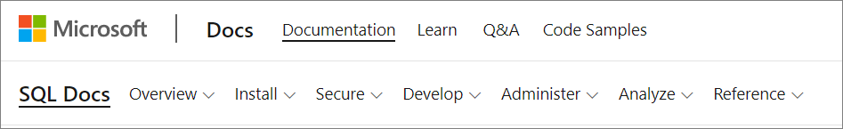
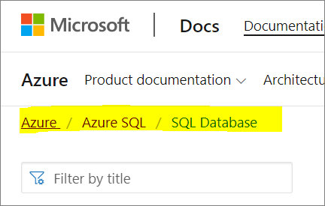
Navigation: Headers & Breadcrumbs
Header:
Navigation bar for quick access to SQL content
Breadcrumbs:
At the top of the page that allows you go to back to a higher level landing or hub page:

Slide 12
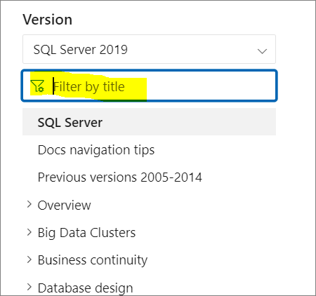
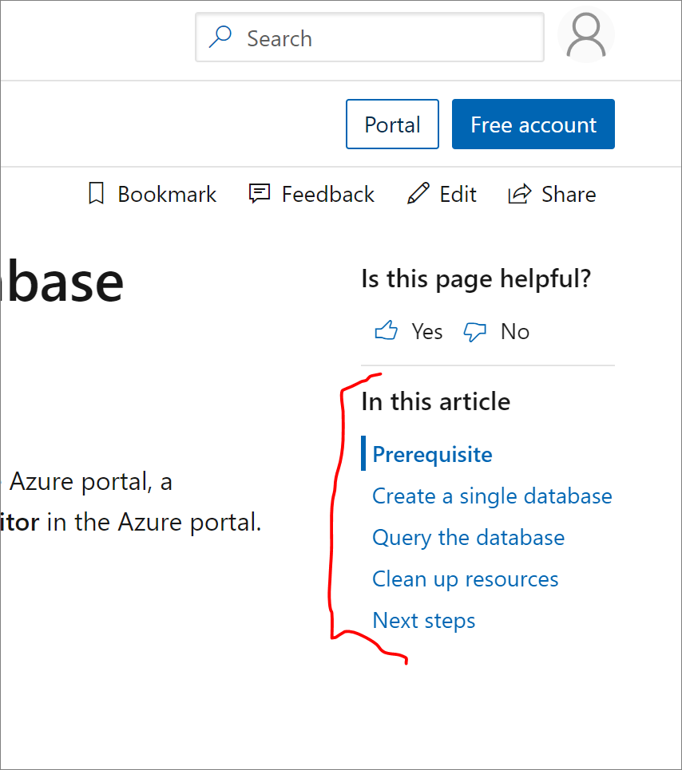
Navigation: TOC + Right Nav
Search the TOC:
Right navigation for H2 links:
Notes:
Poll: Which features do you use regularly and find helpful?

Slide 13
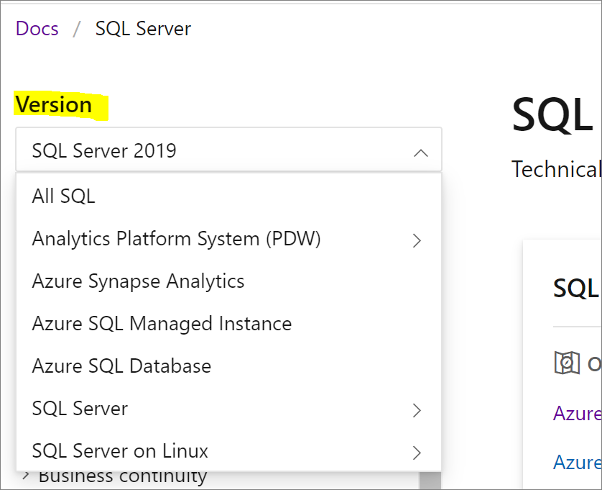
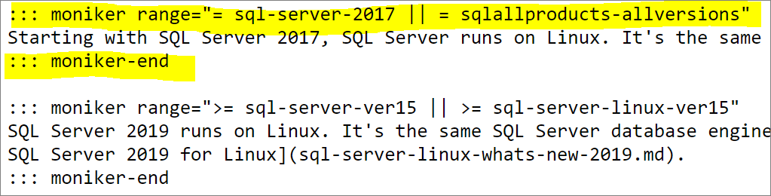
Versioning
Versioning drop-down targets a specific product/service
Changes the table of contents
Changes what you see in an article
Varies depending on article design
SQL Server on Linux (2019)
Notes:
Poll: What is your feedback on versioning in SQL Docs?

Slide 14
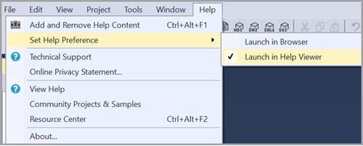
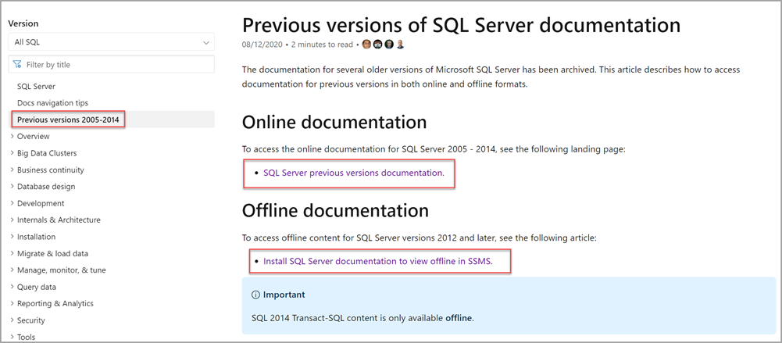
SQL Server offline help (+previous versions)
Previous version content
Offline SQL Server help
Useful if you work in an environment with no online access
SQL Server 2014 T-SQL content only available with offline content
Notes:
Poll: What is your experience with offline books for SQL?

Slide 15
Anyone can help edit SQL Docs!
https://aka.ms/editsqldocs
Be a part of the community and help edit docs. Did you know we have around 15 thousand articles in SQL Docs
You'll have a contributor designation on the article. We average around 16M page views every month
What not to do when editing docs?
Let's do a quick demo
Notes:
Don’t change (links)[link.md] -- add problems as a git issues?

Slide 16



Article feedback and Microsoft Q & A
How do you give documentation feedback?
Not all articles have a feedback button
The documentation feedback button is not Microsoft Support
SQL area of Microsoft Q & A can help with more support-type questions on an article, or if you have feedback on a product, use:

Slide 17
Open discussion… Your feedback on SQL Docs
Notes:
List of questions for discussion here (anyone can ask these):
Did you notice the edit feature? Has anyone edited articles before?
What do you like about the documentation today?
What could be better?
Which of these features and tips are the most surprising or helpful?
How do you most find the things you need in the documentation?

Slide 18
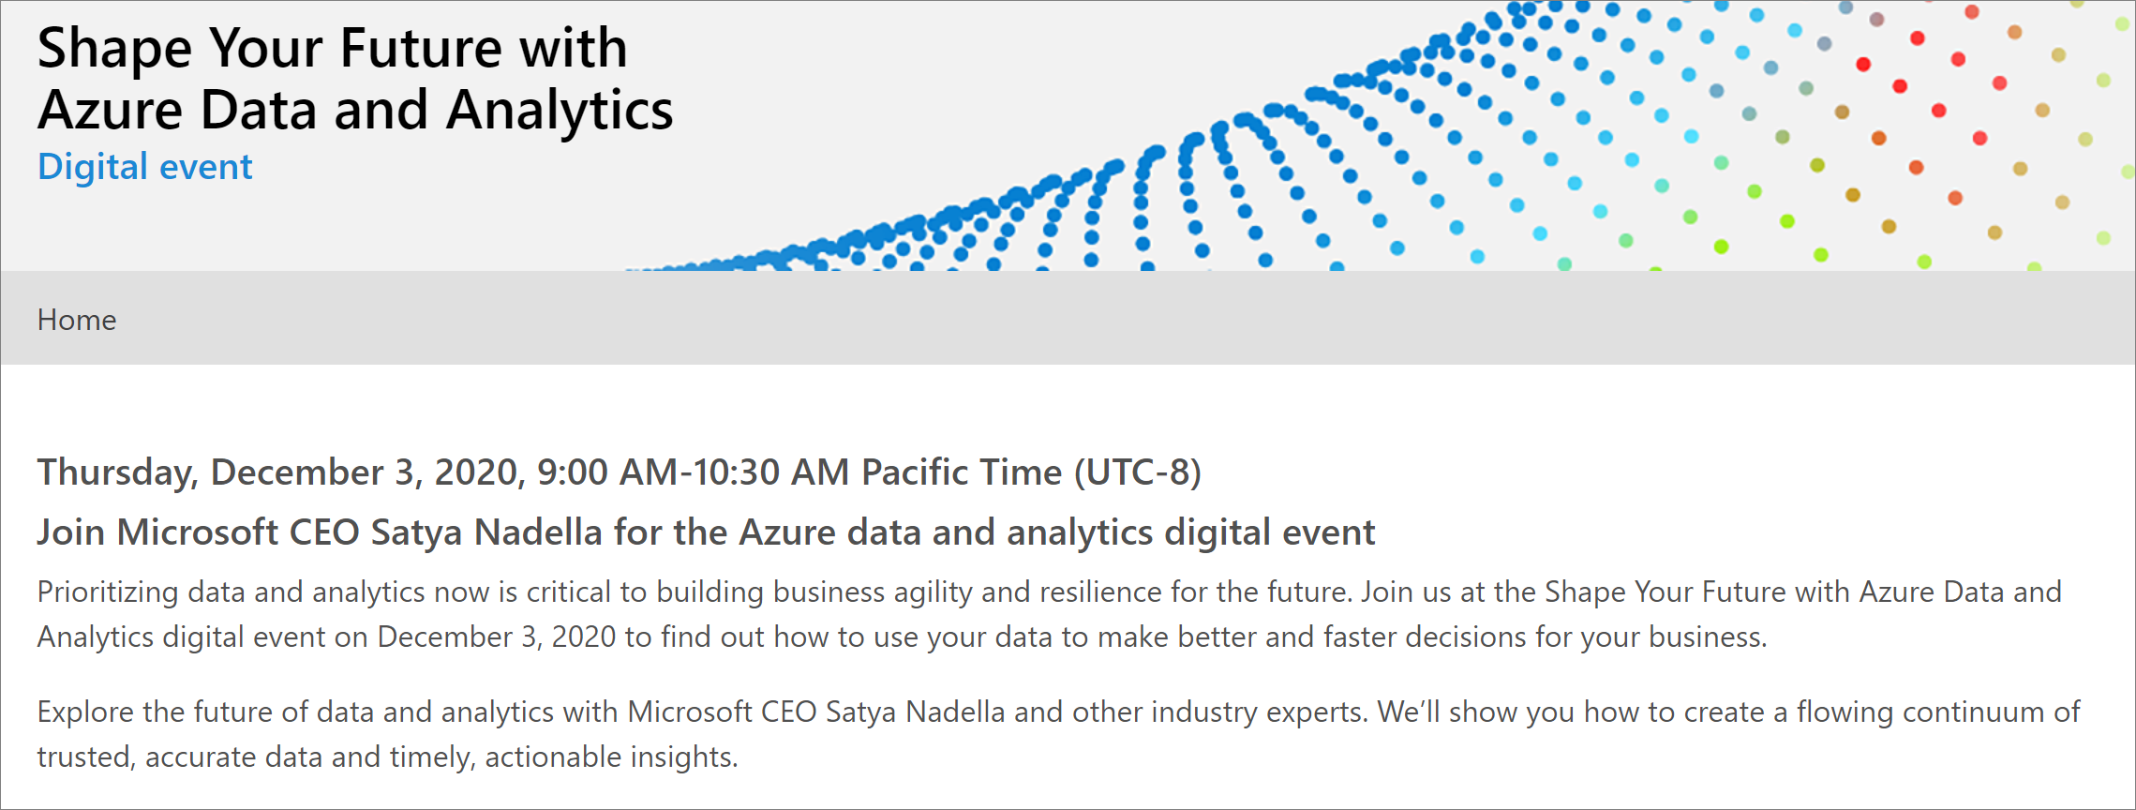
Azure Data and Analytics Digital Event
Join an upcoming Azure Data and Analytics Digital Event
https://azuredataandanalytics2020.eventcore.com/auth/login

Slide 19
Thank you! Reach out to us on Twitter: https://twitter.com/SQLDocs

